Slide 1
Garbage Collector
By
Harrison Fitch,
Neil Medina,
Samuel Poff,
Chanartip Soonthornwan

Slide 2
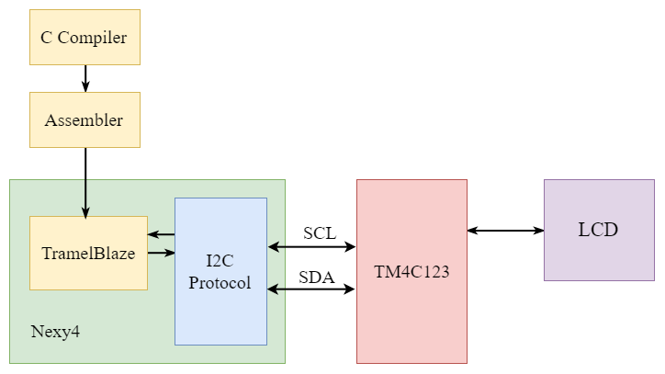
Project Overview
Compiler
FPGA
MCU
LCD

Slide 3
Project Description
Compiler
Assembler
FPGA
I2C
MCU
TM4C123
Display

Slide 4
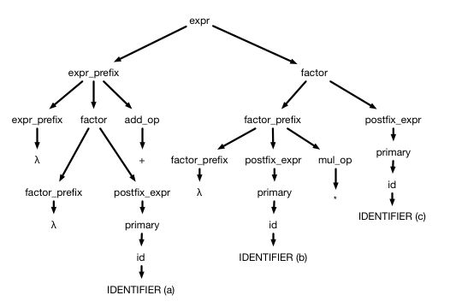
Theory
Compiler
Read .c file
Compile to ASM
Error Checking
Creating .tba file

Slide 5
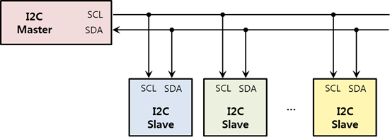
Theory
I2C Protocol
Two Wires Interface
SCL
SDA

Slide 6
Diagrams

Slide 7
References

Slide 8
Demonstration video

Slide 9
Planned

Slide 10
Thank you for participation

